Slide 1
Term Project Phase 7: Presentation by Team OLAPPED CSCI 6401-01
Team Name : OLAPPED
Course : Data Mining
Instructor : Prof. Shivanjali Khare
Course ID : CSCI-6401-01
Session : Fall 2023

Slide 2


About The Team
Team Name :- OLAPPED
Team Member Names :-
(1) Sean Vargas – svarg1@unh.newhaven.edu
(2) Kaylie N Neal – kneal5@unh.newhaven.edu
(3) Prashant Rana – prana4@unh.newhaven.edu
(4) Rajdeep Bhattacharya – rbhat6@unh.newhaven.edu

Slide 3
The Topic
As we had to work on Google what better could be than to work on Google Search Data. We all know Google Search uses parameters and AI to rank its Search Results in SERPs.
We also know that Google Ads provides the advertisers with relevant search placements of their ads.
We used year wise Google Search Data from around the world to isolate patterns by location.
We tried to find a relation between search categories and the location they were searched upon.

Slide 4
Research Question And Scope
The Research Question: - How can the patterns and trends in the Google Search Engine Queries Dataset be used to identify better rules for finding the most promising Keywords (Search Queries) and Topics (Categories) for showing more relevant Search Results in the future.

Slide 5
Motivation
We choose this topic as it can help with information for showing more relevant Search Results in the future and targeting the relevant SERPs (Search Engine Result Pages) for Ad Suggestions by timings (Seasonality) and locations (Geography) for Customer/Viewer Satisfaction and higher Ad Revenues.
This model will be useful for helping with providing information to show relevant and useful ads for the Google Searches.
It can benefit the present society in multiple ways as Google Search is a very important part of our day to day lives.

Slide 6
Literature Review
 | Title Of The Paper | Author(s) Name | Publication Date | Name Of The Publisher | APA Style Citation
I. | A TAIEX forecasting model based on changes of keyword search volume on Google Trends. | Min-Hsuan Fan, En-Chih Liao and Mu-Yen Chen. | Published in 2014 IEEE International Symposium on Independent Computing (ISIC). Date of Conference: 09-12 December 2014. | IEEE. | Shibboleth authentication request. (n.d.). https://ieeexplore-ieee-org.unh- proxy01.newhaven.edu/document/7011756/authors
II. | Reinforcement Learning for Stock Price Trading with Keywords in Google Trends. | Shingchern D. You, Po-Yuan Hsiao and Shengzhe Tsai. | Published in 2023 9th International Conference on Applied System Innovation (ICASI). Date of Conference: 21-25 April 2023. | IEEE. | Shibboleth authentication request. (n.d.-a). https://ieeexplore-ieee-org.unh- proxy01.newhaven.edu/document/10179534/authors#authors
III. | An algorithm based on Google Trends' data for future prediction. Case study: German elections. | Spyros E. Polykalas, George N. Prezerakos and Agisilaos Konidaris. | Published in IEEE International Symposium on Signal Processing and Information Technology. Date of Conference: 12-15 December 2013. | IEEE. | Shibboleth authentication request. (n.d.-a). https://ieeexplore-ieee-org.unh- proxy01.newhaven.edu/document/6781856/authors#authors
IV. | Predicting Automotive Sales using Pre-Purchase Online Search Data. | Philipp Wachter, Tobias Widmer and Achim Klein. | Published in 2019 Federated Conference on Computer Science and Information Systems (FedCSIS). Date of Conference: 12-15 December 2013. | IEEE. | Shibboleth authentication request. (n.d.-a). https://ieeexplore-ieee-org.unh- proxy01.newhaven.edu/document/8860027/authors#authors
V. | Recommending Personalized Search Terms for Assisting Exploratory Website Search. | Young Park. | Published in 2019 ACM/IEEE Joint Conference on Digital Libraries (JCDL). Date of Conference: 02-06 June 2019. | IEEE. | Shibboleth authentication request. (n.d.-a). https://ieeexplore-ieee-org.unh- proxy01.newhaven.edu/document/8791155/authors#authors

Slide 7
Methodology
About the dataset :-
The Data Set is named “trends” as it represents the Google Search Trends for a period of 20 years (2001 - 2020), pointing out the [Top 5 Google Searches (Search Queries)] by [Categories] with their [Global Ranks] and the ranks for the [Top Countries] by [Year].
It has 5 Attributes (represented by 5 columns) namely location, year, category, rank and query. And 26956 Data Points (represented by 26956 rows).

Slide 8

Methodology
The steps we followed to train our model :-
Data Selection.
Data Cleaning.
Data Integration.
Data Reduction.
Data Transformation.
Data Mining.
Pattern Evaluation.
Knowledge Representation.

Slide 9
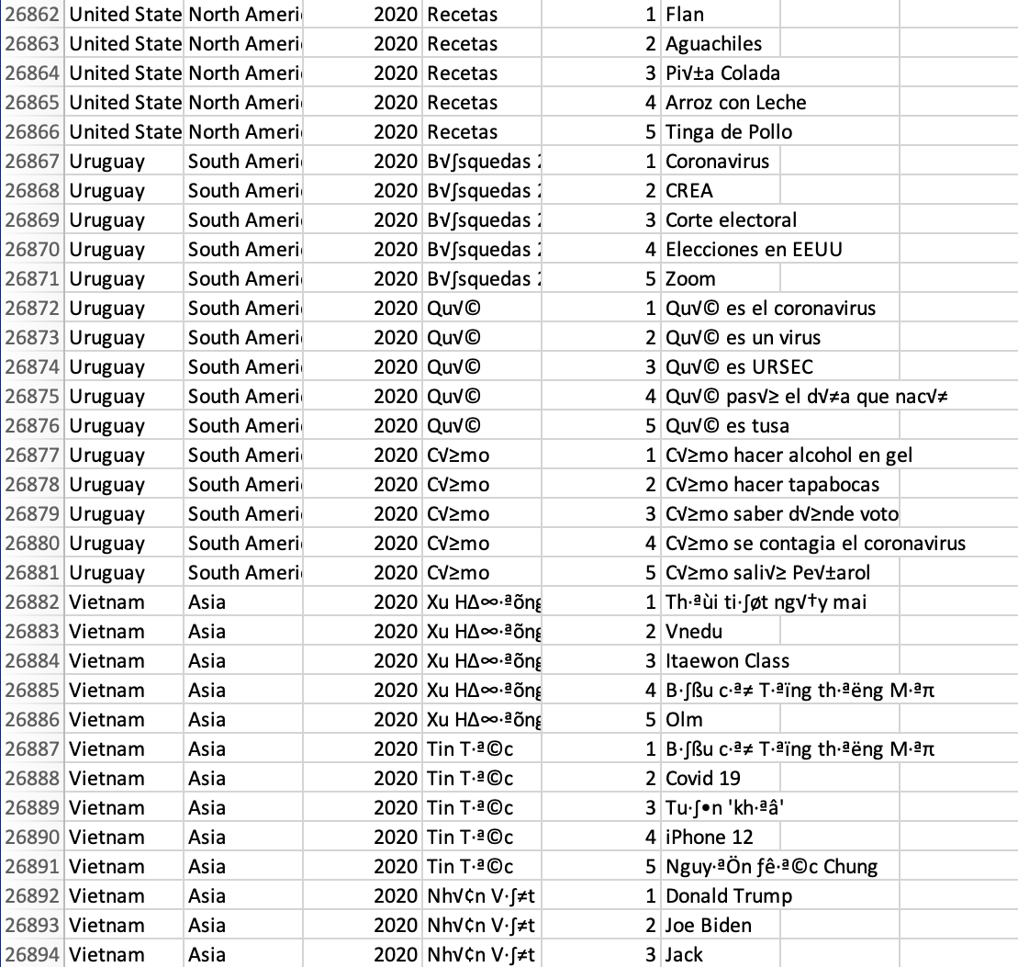
Methodology
What decisions you took?
Firstly, we cleaned the data, there were many illegible fonts inputs, we removed those.
Secondly, we created few extra columns (features) by clubbing two columns like :-
Year and Rank
Continent and Rank
We are still yet to begin Data Exploration.

Slide 10
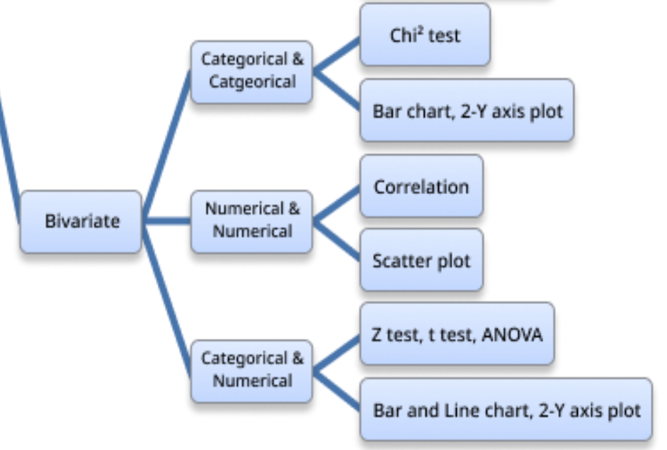
Methodology
What decisions you took?
We studied the data and realized we don’t have many columns, so it has to be a Bivariate Analysis, so we decided to Explore the data with :-
Bivariate Categorical Vs Categorical.
Bivariate Numerical Vs Numerical.
Bivariate Numerical Vs Categorical.

Slide 11

Methodology
We decided on Linear Regression and Isotonic Regression as our model generation techniques, but out of curiosity we also thought of trying out Random Forest.
Parameters :-
For Linear Regression – Y - Intercept and Slope.
For Isotonic Regression – Isotonic Segmentations region.
For Random Forest – n estimators, max features, mini sample leaf, max leaf nodes.

Slide 12
Results
For our modelling, we plotted Linear and Isotonic Regression for top 5 unique categories.
For measuring accuracy of our models, we used Root Mean Squared Error. While RMSE between 0.2 and 0.9 is considered a good model. But due to deficiency of good data in our dataset we got rmse along 1.8 to 2.9. Based on these values, we considered the lowest rmse value a good candidate for our models.
Hence, we selected top 5 categories based on those metrics and plotted our top 5 categories over period of time.
Along the line, we divided our dataset along different continents as most unique patterns can only be found in certain locations.

Slide 13
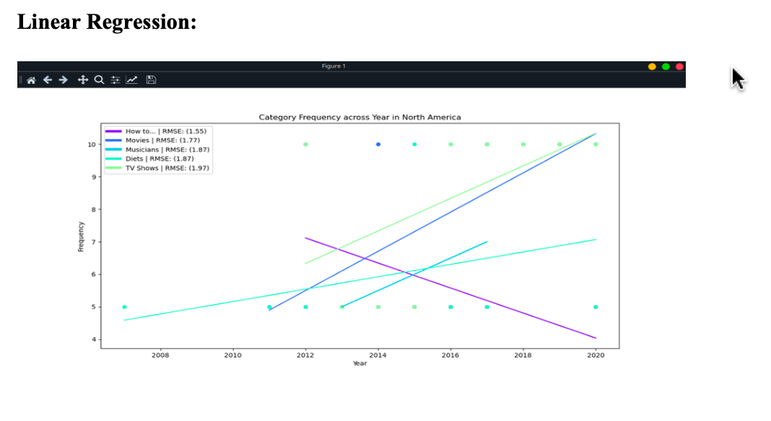
Results
We performed different perspectives of visualization by changing certain metrics, like the minimum observation points required for plotting the model. For Linear regression, minimum observation points required was set to 4 while for Isotonic regression, it was set to 7.

Slide 14
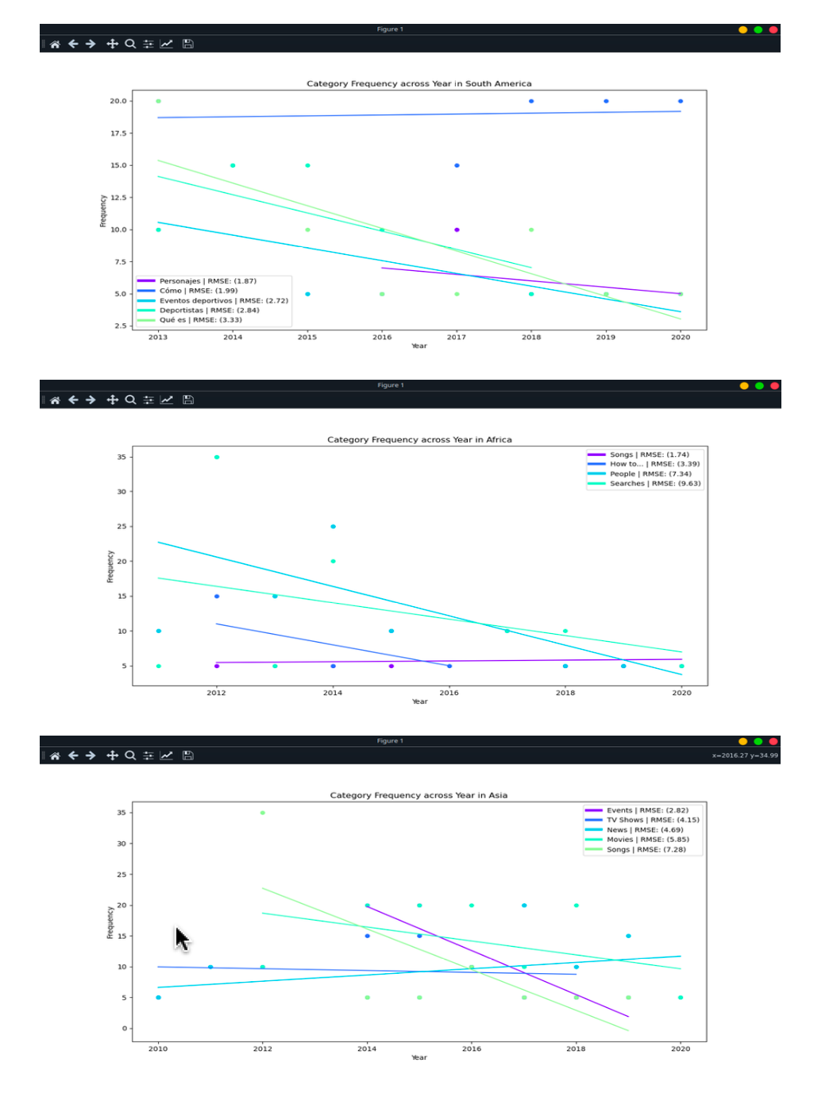
Results

Slide 15
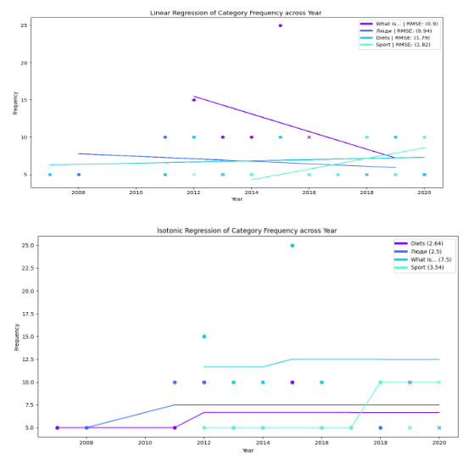
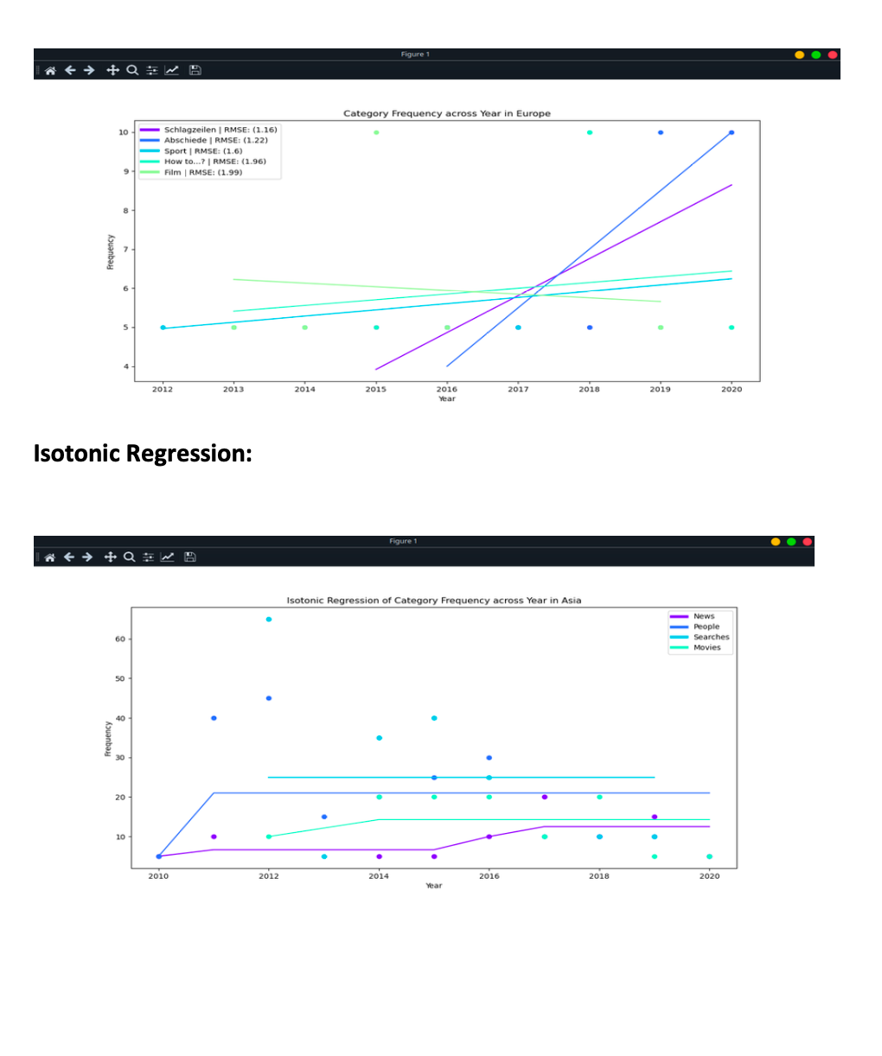
Results

Slide 16
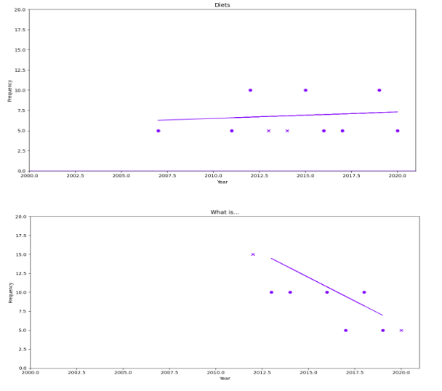
Results

Slide 17
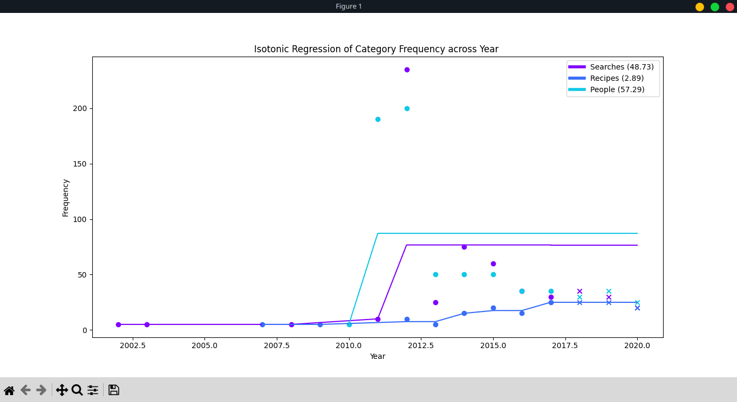
Results

Slide 18

Results
After analyzing the data with Linear Regression and Isotonic Regression, to dig deeper we tried our hands with Random Forest Algorithm based on the concept of bagging. The objective of this project was to find a relation between the greatest number of search categories and the year and continent they are searched on.
While running the program we got a Continent Column from Location with the help of a Countries And Continent Vlookup.
Drawn two Pivot Tables of Category Count by Continent+Rank (Which we created) And Category Count by Year+Rank (Which we created) we fed the data to the algorithm.
We took ‘category’ as countplot named the plot 'Value counts of category'.
As the data was too big we decided to work on Europe.
We put Europe as the filter.

Slide 19
Results
Hyperparameters to Increase the Predictive Power
n_estimators: Number of trees the algorithm builds before averaging the predictions.
max_features: Maximum number of features random forest considers splitting a node.
mini_sample_leaf: Determines the minimum number of leaves required to split an internal node.
criterion: How to split the node in each tree? (Entropy/Gini impurity/Log Loss)
max_leaf_nodes: Maximum leaf nodes in each tree
Hyperparameters to Increase the Speed
n_jobs: it tells the engine how many processors it is allowed to use. If the value is 1, it can use only one processor, but if the value is -1, there is no limit.
random_state: controls randomness of the sample. The model will always produce the same results if it has a definite value of random state and has been given the same hyperparameters and training data.
oob_score: OOB means out of the bag. It is a random forest cross-validation method. In this, one-third of the sample is not used to train the data; instead used to evaluate its performance. These samples are called out-of-bag samples.

Slide 20
Conclusion
I. Gradient Descent (For Linear And Isotonic Regression)
In this Gradient Descent implementation, the code iterates through unique categories in a DataFrame, performing linear regression using gradient descent to optimize the coefficients for each category. The process involves preprocessing data by filtering and grouping, followed by a loop for each category. Key components include setting hyperparameters such as the number of iterations and learning rate. Data is split into training and testing sets using scikit-learn's train_test_split, and accuracy is evaluated during the gradient descent process. Visualization includes plots of the best-fit line for each category and a verification plot showing the decrease in the cost function over iterations. Challenges include observed issues with accuracy improvement and displaying the verification plot, which need further investigation and debugging. Potential improvements involve careful debugging and code refactoring for modularity and clarity.
As observed, the model doesn’t converges to optimal value so our first model is expected to be an optimal solution. As the data is already converged while modelling our linear regression, the model is optimum and with as many iterations no improvement is seen.

Slide 21
Conclusion
II. GridSearchCV (For Random Forest Algorithm)
Cleaned the data of unreadable inputs.
Created a Continent Column from Location with the help of a Countries And Continent Vlookup. Drawn two Pivot Tables of Category Count by Continent+Rank (Which we created) And Category Count by Year+Rank (Which we created) we fed the data to the algorithm. We took ‘category’ as countplot named the plot 'Value counts of category’. As the data was too big we decided to work on Europe. We put Europe as the filter. Then we split the data into Train And Test Set.
It ran with, Fitting 4 folds for each of 180 candidates, totalling 720 fits.
The plan was to do Hyperparameter Tuning using GridSearchCV. But the model didn’t converge. This Data is not fit for Random Forest.

Slide 22
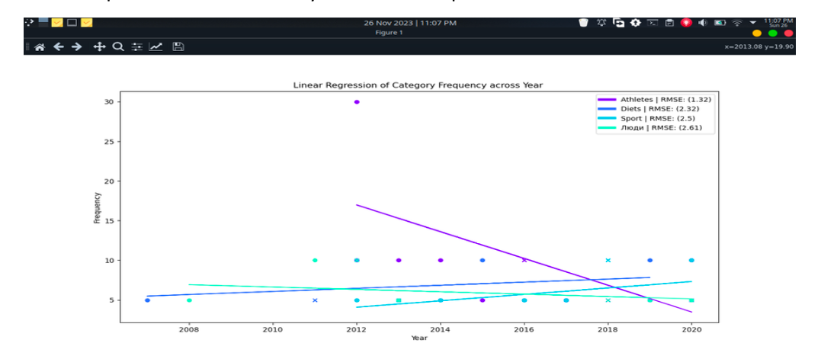
Conclusion
Amongst the three Algorithms tried the Linear Regression And Isotonic Regression converges at the Parameter Level while the Random Forest Algorithm doesn’t converges at all.
Amongst the Linear and Isotonic Regression the Linear Regression did good at the Hyperparameter Tuning Level.
As observed, the model doesn’t converges to optimal value so our first model is expected to be an optimal solution. As the data is already converged while modelling our linear regression, the model is optimum and with as many iterations no improvement is seen.

Slide 23
Conclusion
Our research question when simply put states that we are trying to find correlation between Location, Year and Search Categories.
We can see from the Linear Regression Diagram that Athletics, Diets and Sports did good in Europe in 2018.
Further deep dives might give more such convergences.

Slide 24
The limited availability of data added to a tough schedule proved to be a problem. Also we are students with limited knowhow, that too was an issue. And ML is a multi person job with specialists input which again and again made it clear to us
Limitations

Slide 25
Given the right opportunity we would definitely like to work on it again delving further.
Future Work

